Slide 1
COMP / IT 420: MySQL
Setting up and Connecting to CI Keys

Slide 2
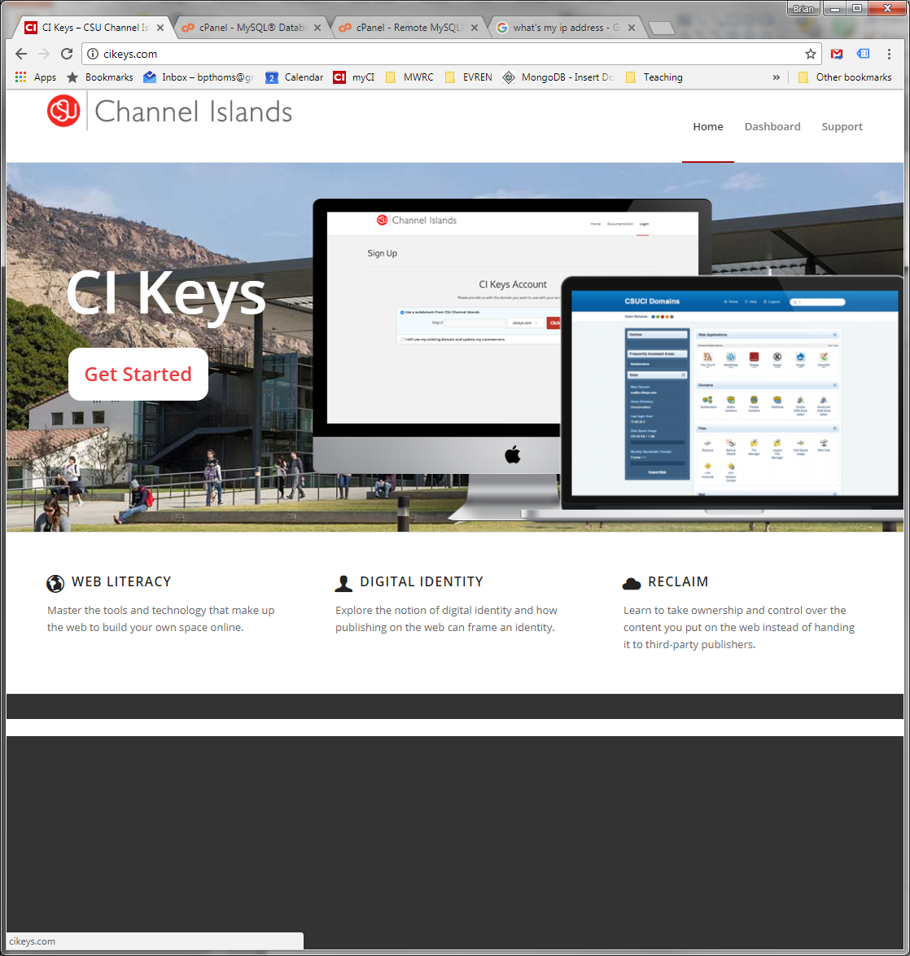
CI Keys: Get Started

Slide 3
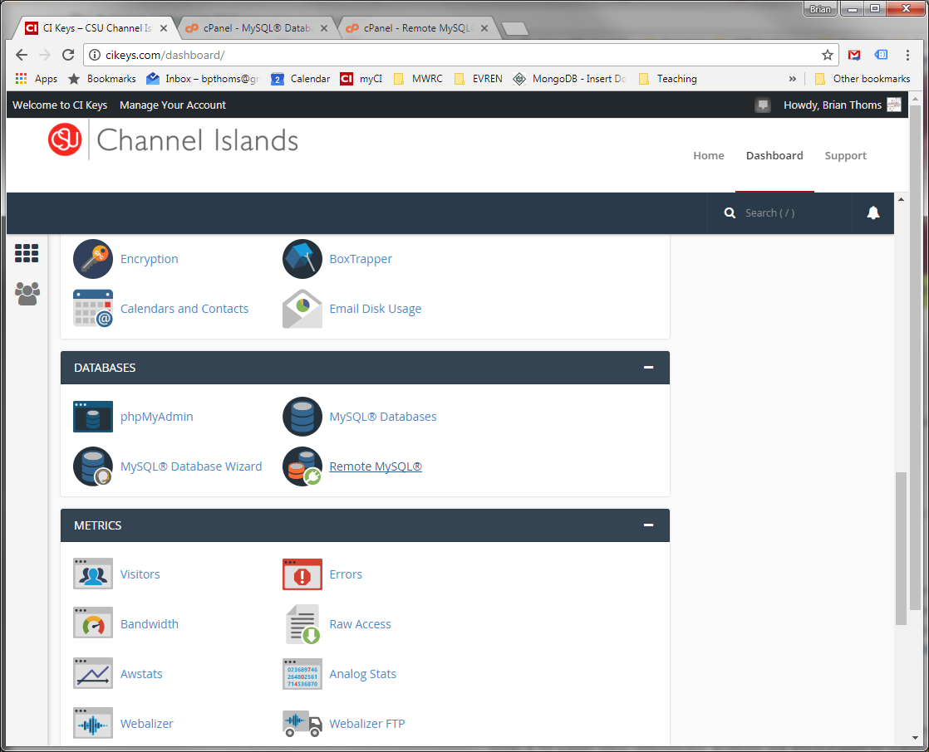
MySQL Databases

Slide 4
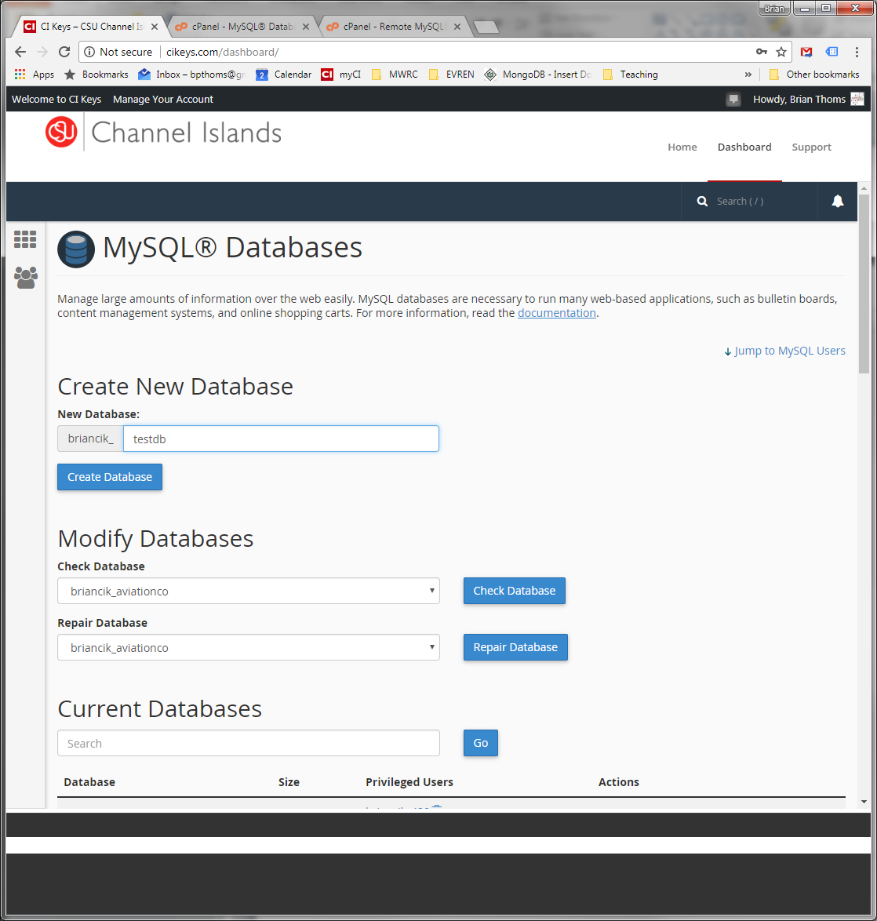
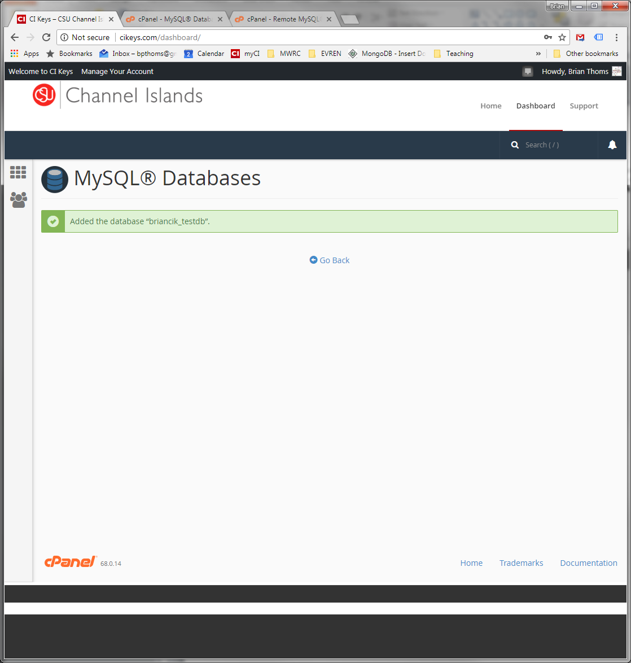
Create New Database
Notice how the database is prepended with your cikeys name.

Slide 5
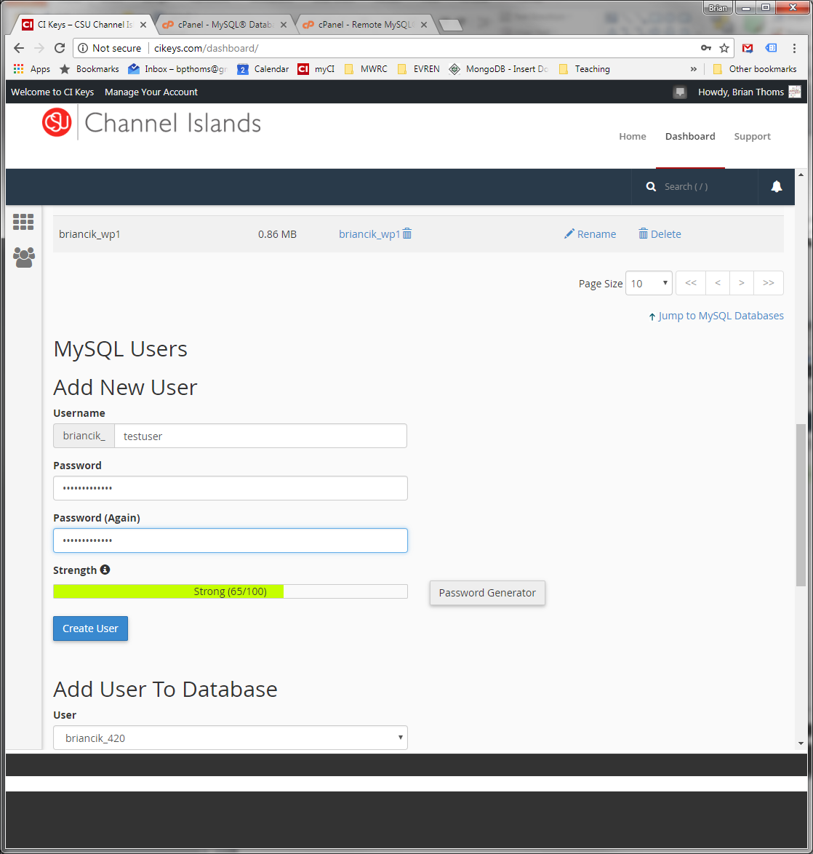
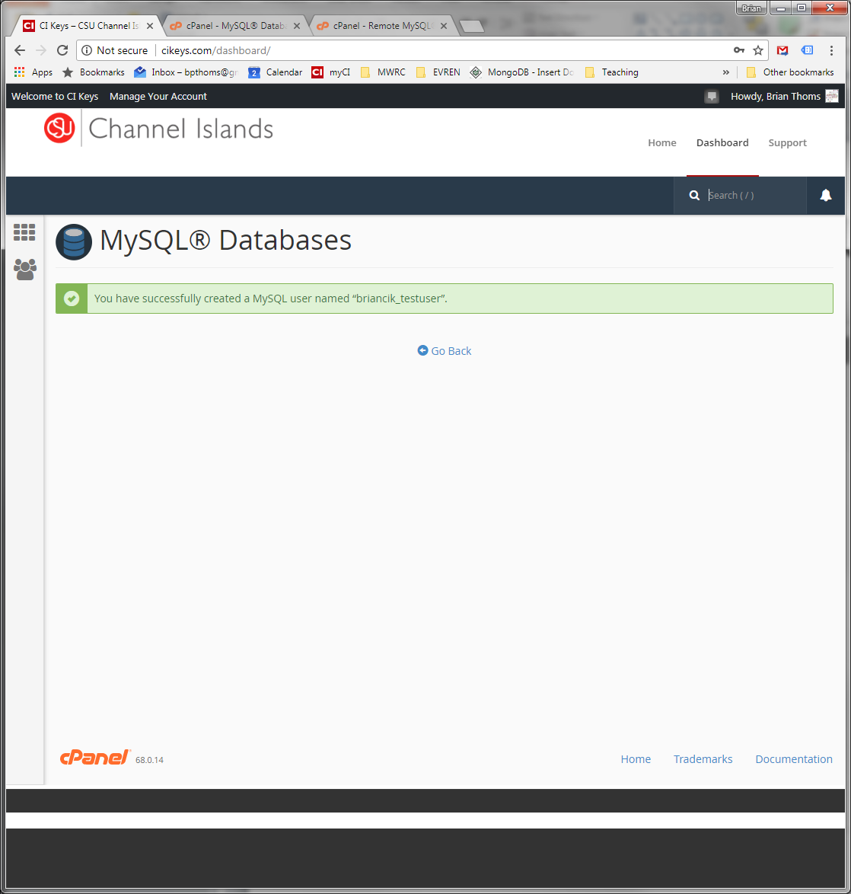
Create New DB User

Slide 6
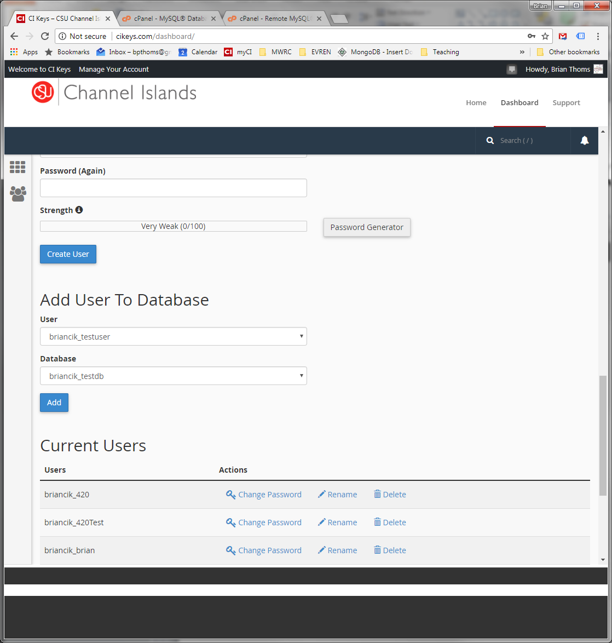
Add User to DB

Slide 7
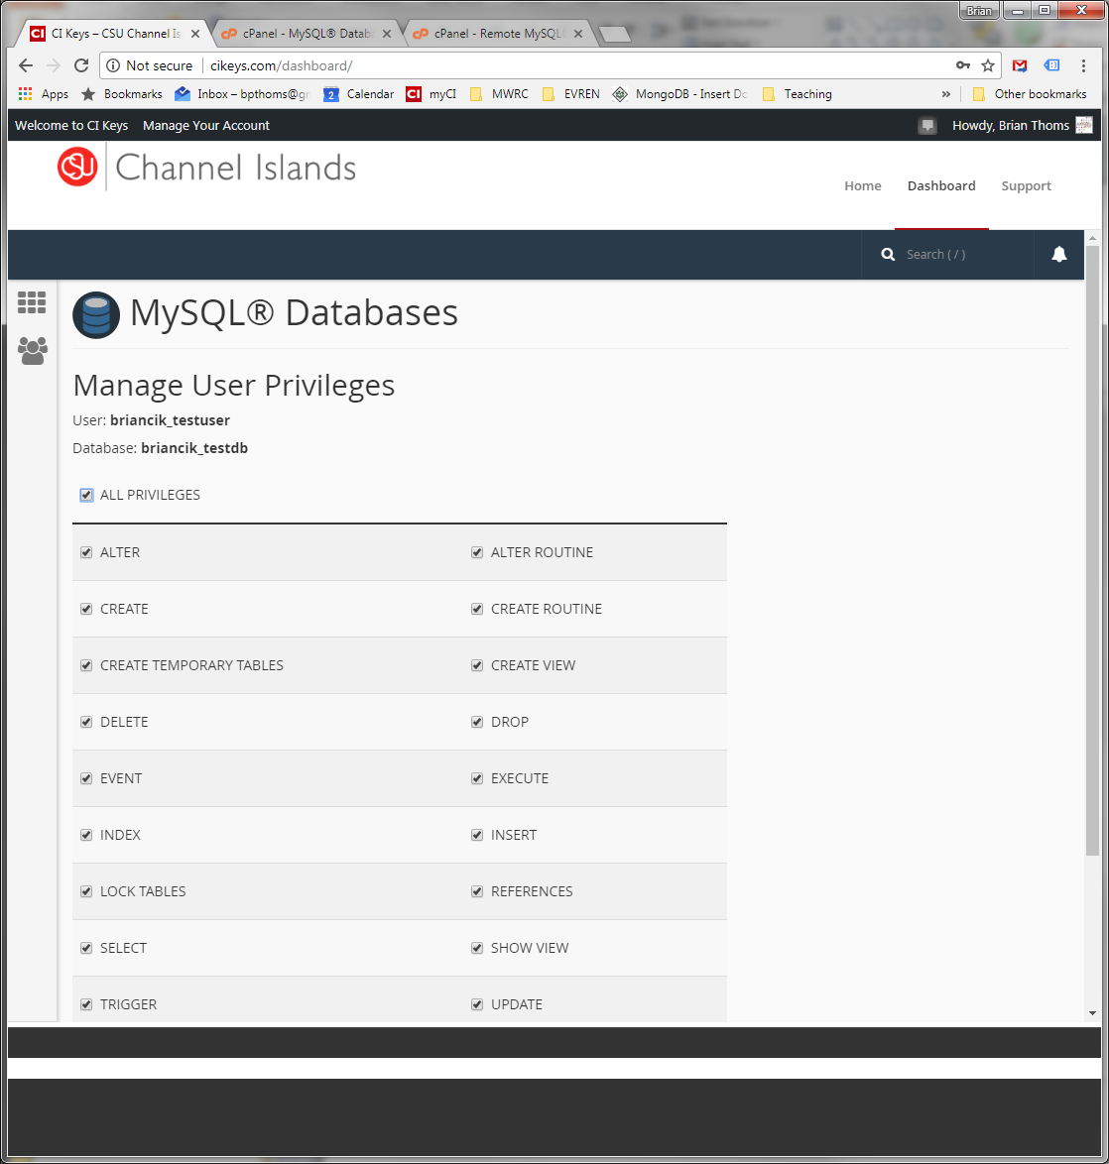
Add Privileges to User

Slide 8
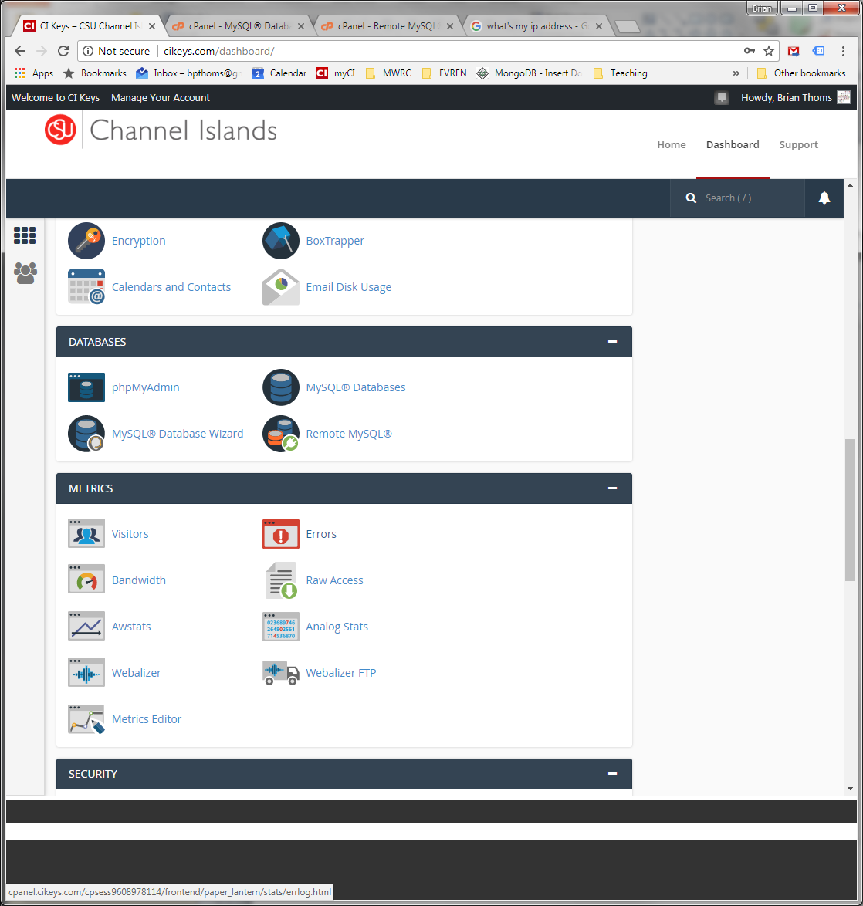
Dashboard: Remote SQL

Slide 9
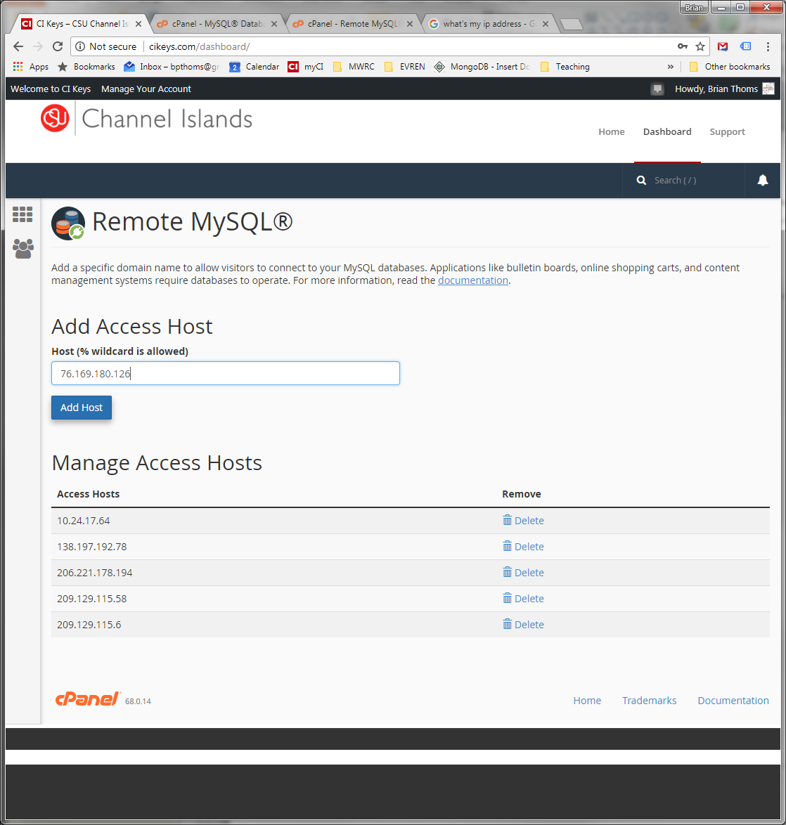
Whitelist your IP Address

Slide 10
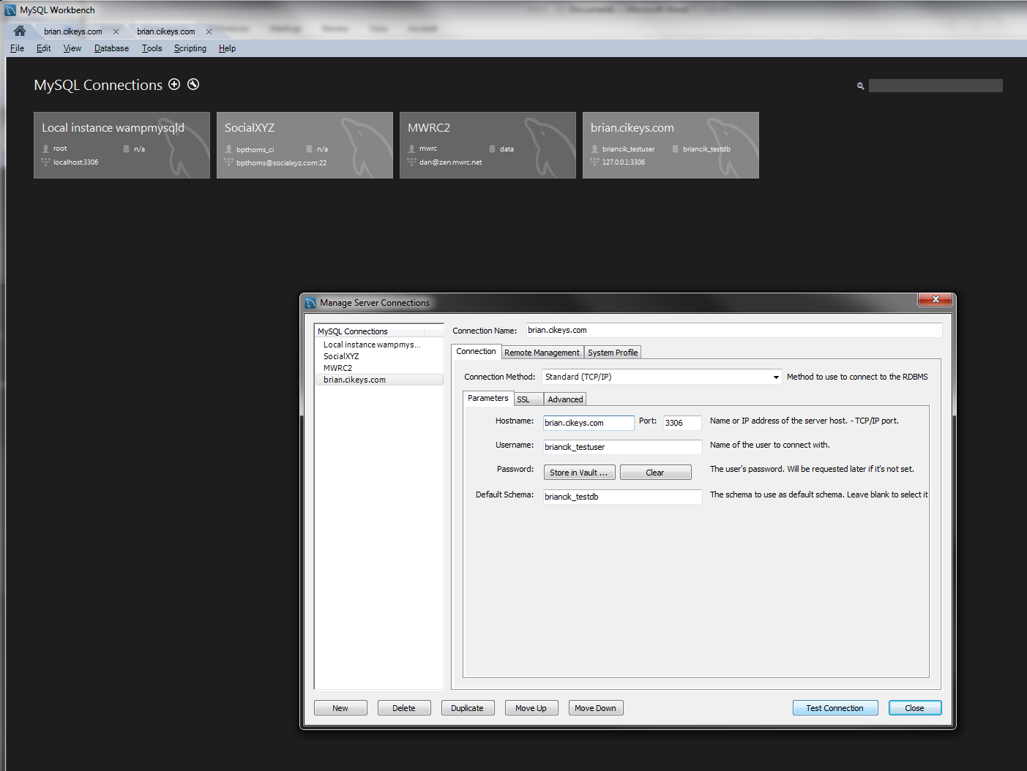
Workbench: Set up New Connection

Slide 11
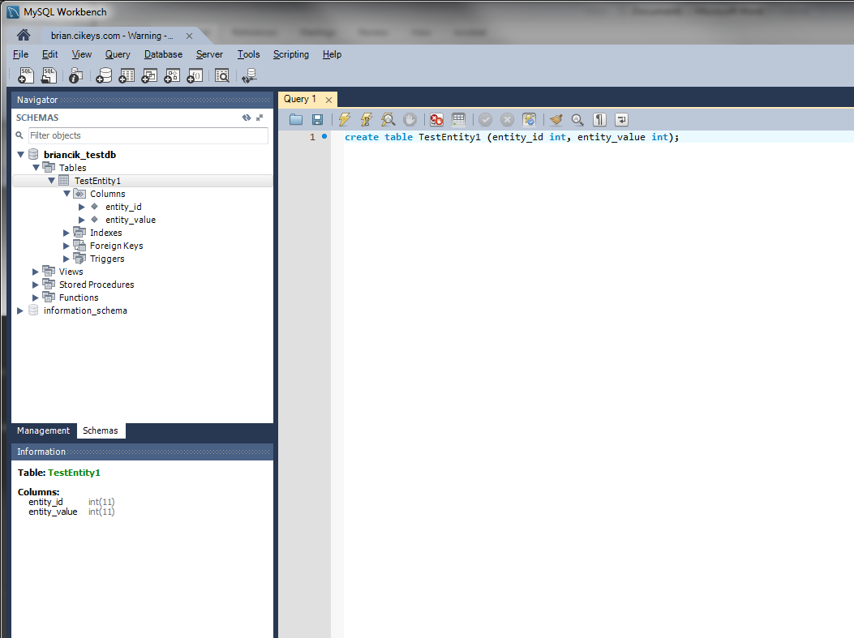
Creating DB Objects and Run Queries (Ch. 7 & Ch. 8)

